Slide 1

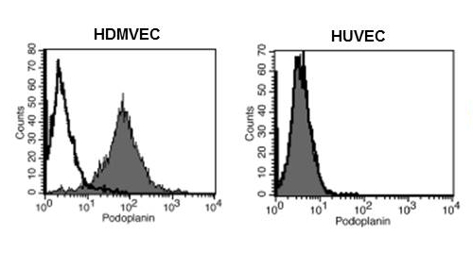
ReliaTech GmbH
Mouse anti-human Podoplanin
(Cat #101-M40)
Fig. 1: FACS analysis with primary human dermal microvascular endothelial cells (HDMEC) and umbilical vein endothelial cells (HUVEC) using a monoclonal mouse anti-human Podoplanin antibody.
http://www.reliatech.de / orders@reliatech.de

